Slide 1
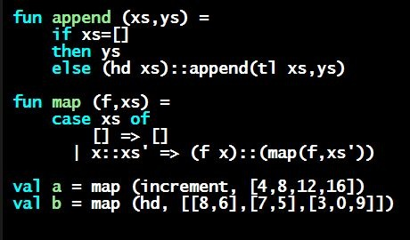
Programming Languages
Dan Grossman
Another Equivalent Structure

Slide 2
More interesting example
Given a signature with an abstract type, different structures can:
  Have that signature
  But implement the abstract type differently
Such structures might or might not be equivalent
Example (see code):
  type rational = int * int
  Does not have signature RATIONAL_A
  Equivalent to both previous examples under RATIONAL_B or RATIONAL_C

Slide 3
More interesting example
structure Rational3 =
struct
type rational = int * int
exception BadFrac
fun make_frac (x,y) = …
fun Whole i = (i,1) (* needed for RATIONAL_C *)
fun add ((a,b)(c,d)) = (a*d+b*c,b*d)
fun toString r = … (* reduce at last minute *)
end

Slide 4
Some interesting details
Internally make_frac has type int * int -> int * int, but externally int * int -> rational
  Client cannot tell if we return argument unchanged
  Could give type rational -> rational in signature, but this is awful: makes entire module unusable – why?
Internally Whole has type 'a -> 'a * int but externally int -> rational
  This matches because we can specialize 'a to int and then abstract int * int to rational
  Whole cannot have types 'a -> int * int or 'a -> rational (must specialize all 'a uses)
  Type-checker figures all this out for us

